Slide 1

TOSC Printout Template
Follow instructions in the notes under the slides
9901 Brodie Lane, Ste 160 #257 www.tosc.org txorthostudy@gmail.com
Austin, Tx 78748
Notes:
Welcome to our effort to simplify presenting your cases during our annual TOSC meeting. This TOSC template should help to present our cases in a uniform format. The images are in the order that they should be placed in the notebook. Remember to print a coversheet for the outside of your notebook off of the template provided on the website as well as a case summary sheet to be placed on the inside of your notebook. Each slide should be printed from your printer with the appropriate paper so that the images are clear for review. The instructions for changing the information on the template is provided on each slide in the initial sections of the power point. There are additional sections for additional records should you have them for your patient. I would recommend keeping your slide format in the 4:3 format presented for printing. It is best to make a copy of the template file and keep the original template unchanged for future use should your copy become corrupt for some reason.

Slide 2
Doctor Name
Case Type
Meeting Location
Meeting Date
9901 Brodie Lane, Ste 160 #257 www.tosc.org txorthostudy@gmail.com
Austin, Tx 78748
Notes:
This will be your Notebook Cover template to be used as your notebook coversheet. Case type will be one of 6 categories: Non-extraction (non-surgery), Multiphase treatment, Extraction (non-surgery), Surgery, Mutilated (teeth missing before treatment), Problem cases.

Slide 3
Devek Frech
Notebook Cover Example
Non-extraction
San Antonio
January 26-29, 2017
9901 Brodie Lane, Ste 160 #257 www.tosc.org txorthostudy@gmail.com
Austin, Tx 78748
Notes:
This will be your Notebook Cover template to be used as your notebook coversheet. Case type will be one of 6 categories: Non-extraction (non-surgery), Multiphase treatment, Extraction (non-surgery), Surgery, Mutilated (teeth missing before treatment), Problem cases.

Slide 4
Case Description Summary
1. Extraction / Non-extraction / Surgery / Mutilated…
2. Appliances Used: 022 Roth Rx Braces?, TADs, RPE, lingual arch, etc.
3. Mechanics Used: Elastics, Anchorage required, etc.
Case Classification, Timeline, and Retention Details
Case # #1
Beginning age Years-Months
Angle Class Class I, II, III, …
Date Begun Braces placed: Date Mo / Day / Year
Date Finished Braces, Appliances removed Mo / Day / Year
Treatment Time Length of time in treatment in months
Type of Retention Type of upper retainer
Type of lower retainer
Patient Name
9901 Brodie Lane, Ste 160 #257 www.tosc.org txorthostudy@gmail.com
Austin, Tx 78748
Notes:
This will be your Case Description Summary sheet. This sheet will go on the inside of the notebook front cover and provide and more detailed description of your patient for review.

Slide 5
Case Description Summary
1. Extracted 5s
2. 022 Roth Rx Braces
3. Minimal anchorage with Class 2 elastics)
Case Classification, Timeline, and Retention Details
Case # #1
Beginning age 12-8
Angle Class Class II
Date Begun Diagnosis: 6-1-2009 / Braces placed: 4-19-2010
Date Finished 4-24-2012
Treatment Time 24 months
Type of Retention Maxillary essix
Mandibular Fixed 3-3 with essix overlay
Case Description Example
Patient Name
9901 Brodie Lane, Ste 160 #257 www.tosc.org txorthostudy@gmail.com
Austin, Tx 78748
Notes:
This will be your Case Description Summary sheet. This sheet will go on the inside of the notebook front cover and provide and more detailed description of your patient for review.

Slide 6
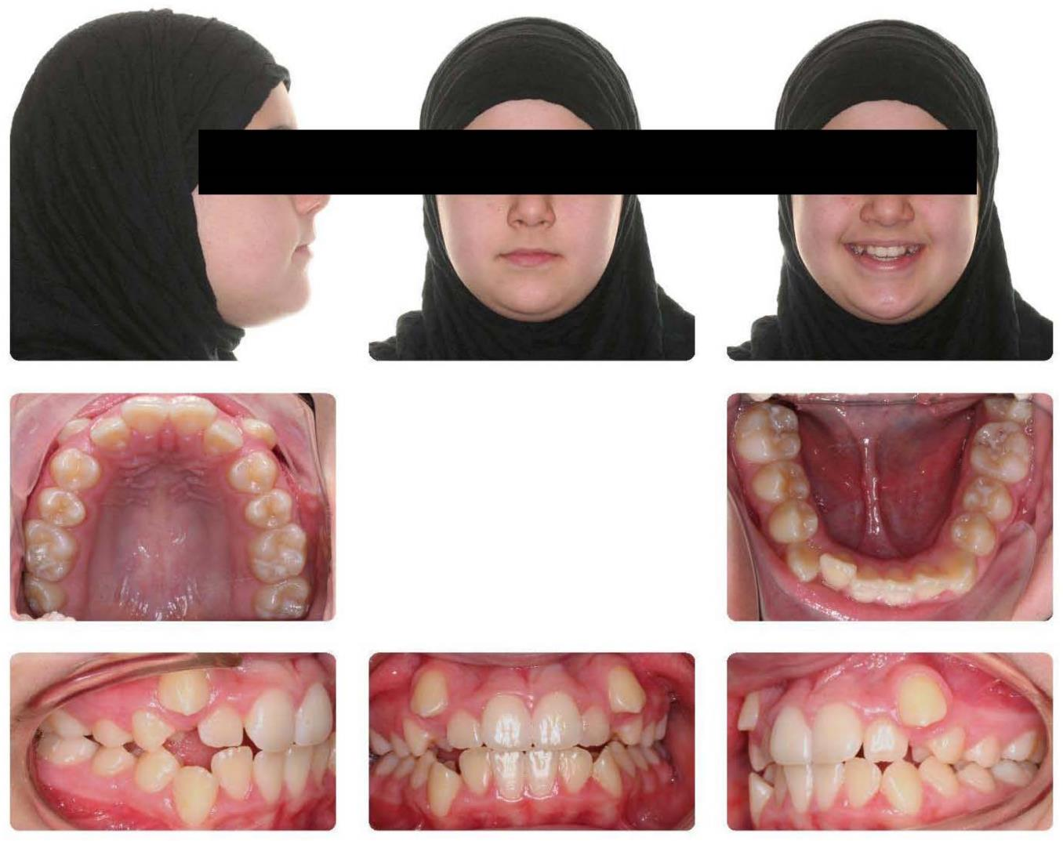
NAME Initial
Date Age
Notes:
To change the picture, right click on the picture or photos and choose change picture. (You can choose change picture from the format picture menu as well) Select the file or picture that you want to replace the photos with from your computer. The “virtual labels” are moveable or not set so that you may move them as needed for your photos. Simply change the name, the date, and the age in the label. You can copy and paste this label into the other slides to save time or retype the information. If you copy and paste the label, you will need to copy and paste the “black dot” as well.

Slide 7
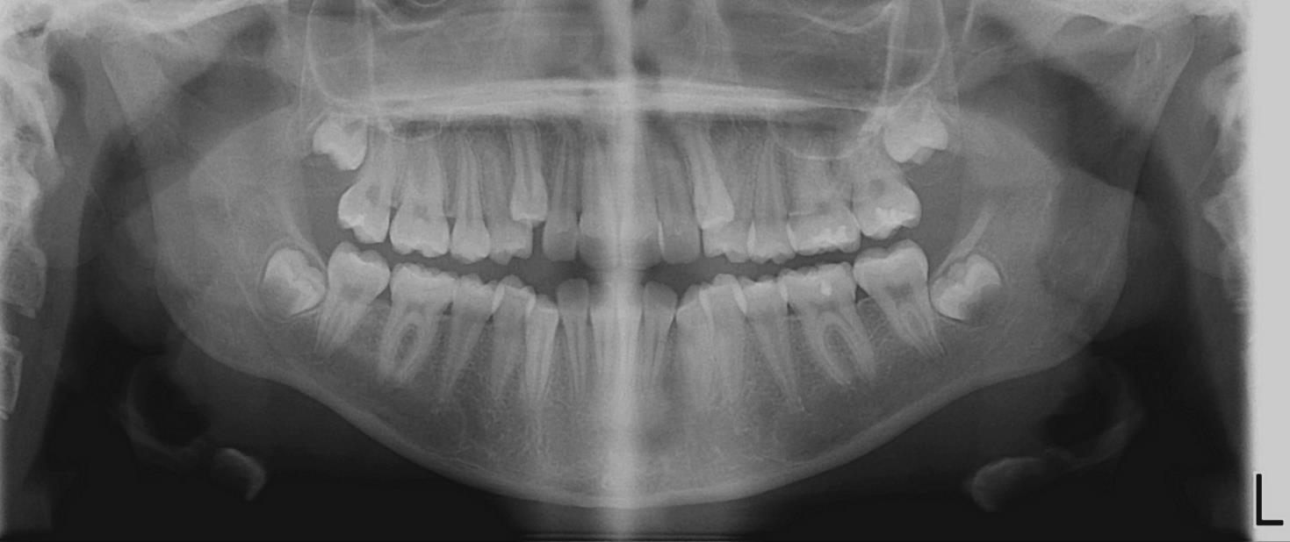
NAME Initial
Date Age
Notes:
To change the picture, right click on the picture or photos and choose change picture. (You can choose change picture from the format picture menu as well) Select the file or picture that you want to replace the photos with from your computer. The “virtual labels” are moveable or not set so that you may move them as needed for your photos. Simply change the name, the date, and the age in the label. You can copy and paste this label into the other slides to save time or retype the information. If you copy and paste the label, you will need to copy and paste the “black dot” as well.

Slide 8
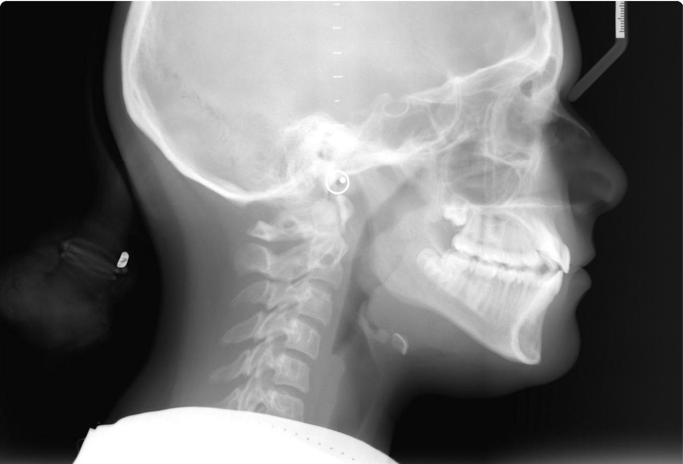
NAME Initial
Date Age
Notes:
To change the picture, right click on the picture or photos and choose change picture. (You can choose change picture from the format picture menu as well) Select the file or picture that you want to replace the photos with from your computer. The “virtual labels” are moveable or not set so that you may move them as needed for your photos. Simply change the name, the date, and the age in the label. You can copy and paste this label into the other slides to save time or retype the information. If you copy and paste the label, you will need to copy and paste the “black dot” as well.

Slide 9
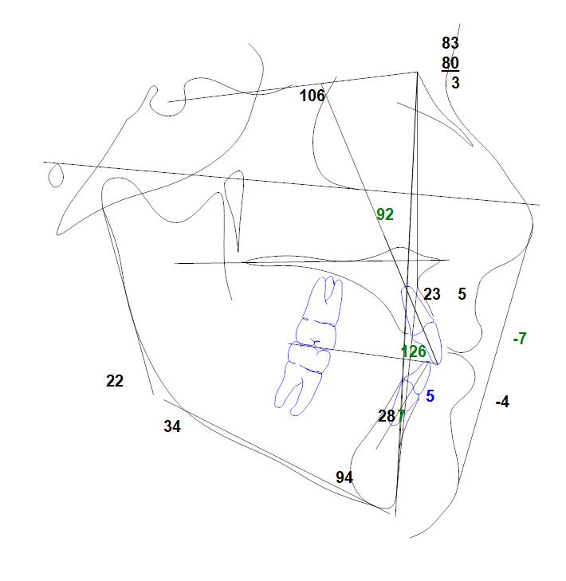
NAME Initial
Date Age
Notes:
To change the picture, right click on the picture or photos and choose change picture. (You can choose change picture from the format picture menu as well) Select the file or picture that you want to replace the photos with from your computer. The “virtual labels” are moveable or not set so that you may move them as needed for your photos. Simply change the name, the date, and the age in the label. You can copy and paste this label into the other slides to save time or retype the information. If you copy and paste the label, you will need to copy and paste the “black dot” as well. FOR TRACINGS- your imaging program can export these as jpegs or these can be printed to a pdf file and exported as a jpeg or copied as a pdf into the slide. To get a more proportionate tracing that will overlay your head film, please see the ABO website for details on this procedure.

Slide 10
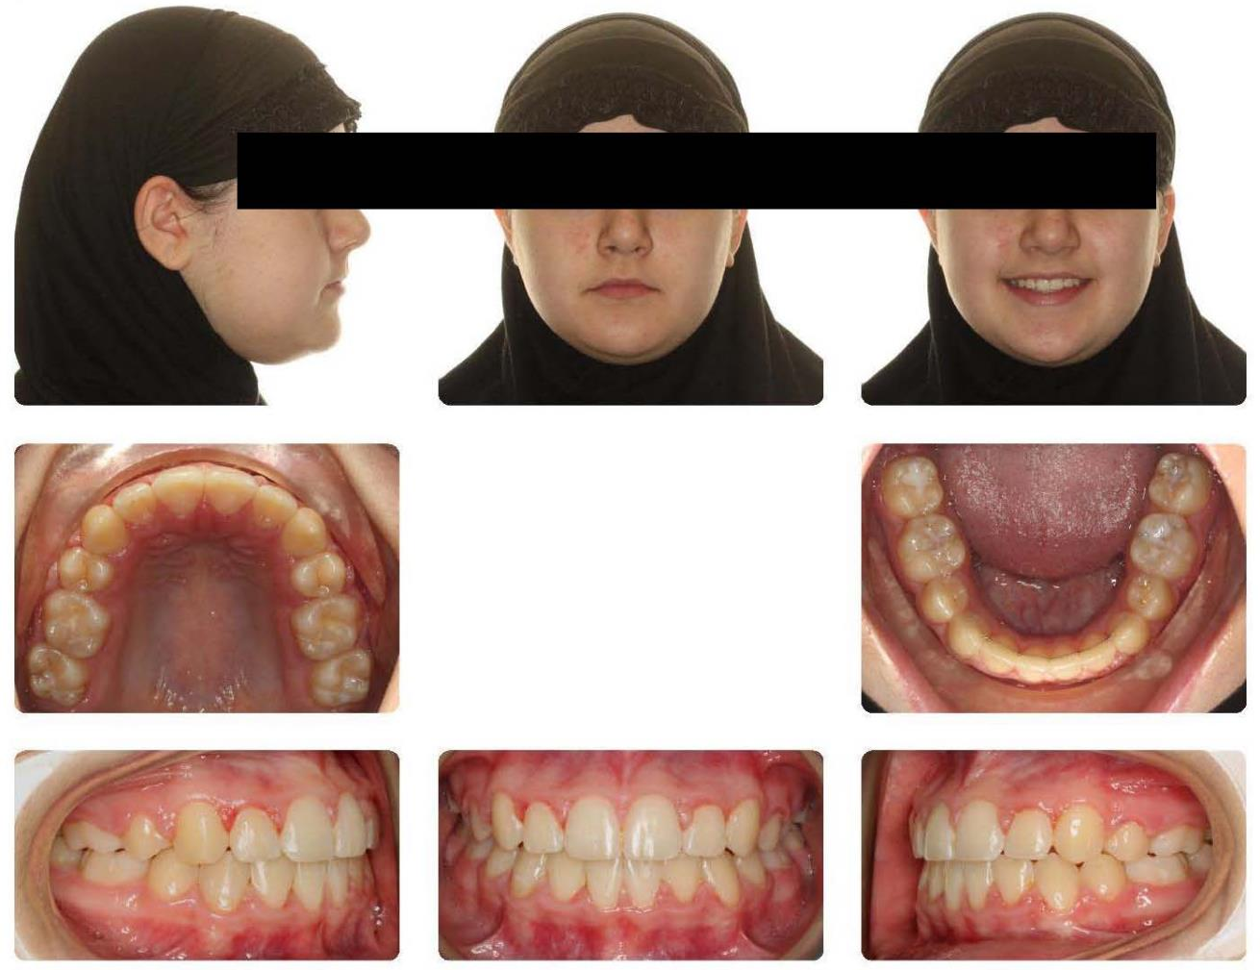
NAME Final
Date Age
Notes:
To change the picture, right click on the picture or photos and choose change picture. (You can choose change picture from the format picture menu as well) Select the file or picture that you want to replace the photos with from your computer. The “virtual labels” are moveable or not set so that you may move them as needed for your photos. Simply change the name, the date, and the age in the label. You can copy and paste this label into the other slides to save time or retype the information. If you copy and paste the label, you will need to copy and paste the “black dot” as well.

Slide 11
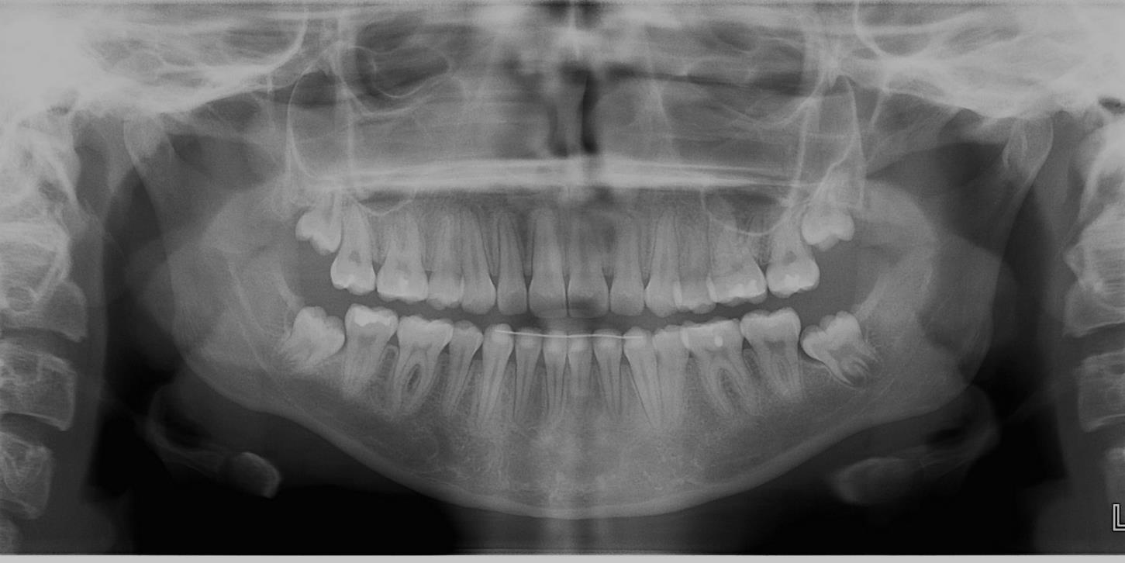
NAME Final
Date Age
Notes:
To change the picture, right click on the picture or photos and choose change picture. (You can choose change picture from the format picture menu as well) Select the file or picture that you want to replace the photos with from your computer. The “virtual labels” are moveable or not set so that you may move them as needed for your photos. Simply change the name, the date, and the age in the label. You can copy and paste this label into the other slides to save time or retype the information. If you copy and paste the label, you will need to copy and paste the “black dot” as well.

Slide 12
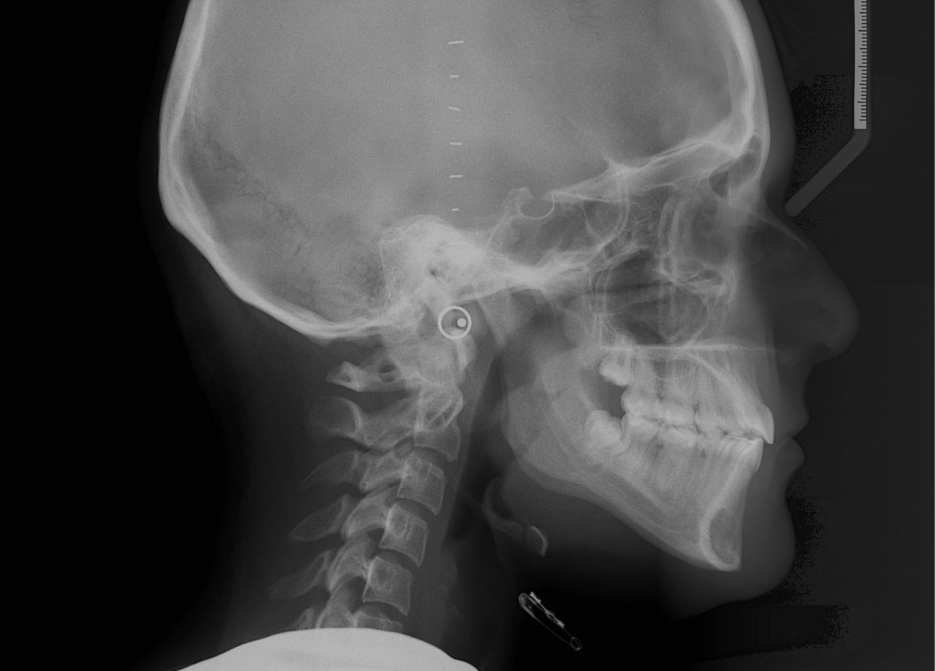
Name Final
Date Age
Notes:
To change the picture, right click on the picture or photos and choose change picture. (You can choose change picture from the format picture menu as well) Select the file or picture that you want to replace the photos with from your computer. The “virtual labels” are moveable or not set so that you may move them as needed for your photos. Simply change the name, the date, and the age in the label. You can copy and paste this label into the other slides to save time or retype the information. If you copy and paste the label, you will need to copy and paste the “black dot” as well.

Slide 13
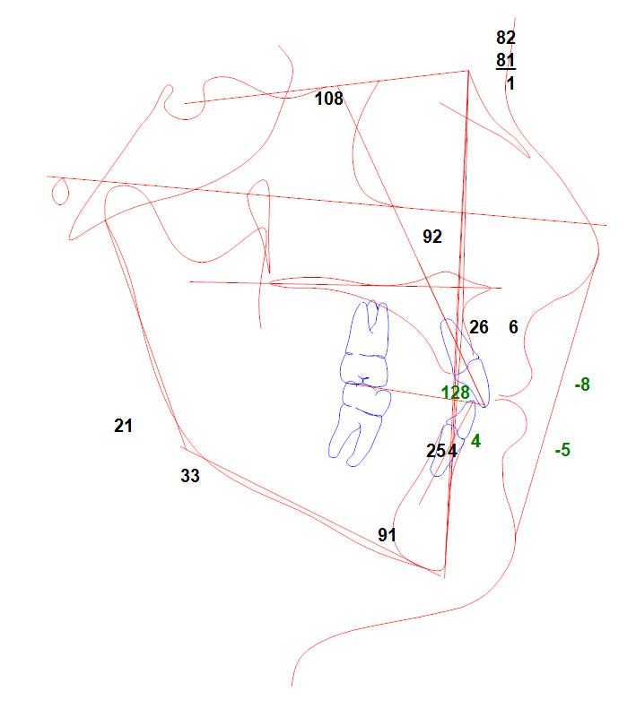
NAME Final
Date Age
Notes:
To change the picture, right click on the picture or photos and choose change picture. (You can choose change picture from the format picture menu as well) Select the file or picture that you want to replace the photos with from your computer. The “virtual labels” are moveable or not set so that you may move them as needed for your photos. Simply change the name, the date, and the age in the label. You can copy and paste this label into the other slides to save time or retype the information. If you copy and paste the label, you will need to copy and paste the “black dot” as well. FOR TRACINGS- you can change the colors of your tracings in your imaging software and export them as jpegs or pdfs and then import them into the slides.

Slide 14
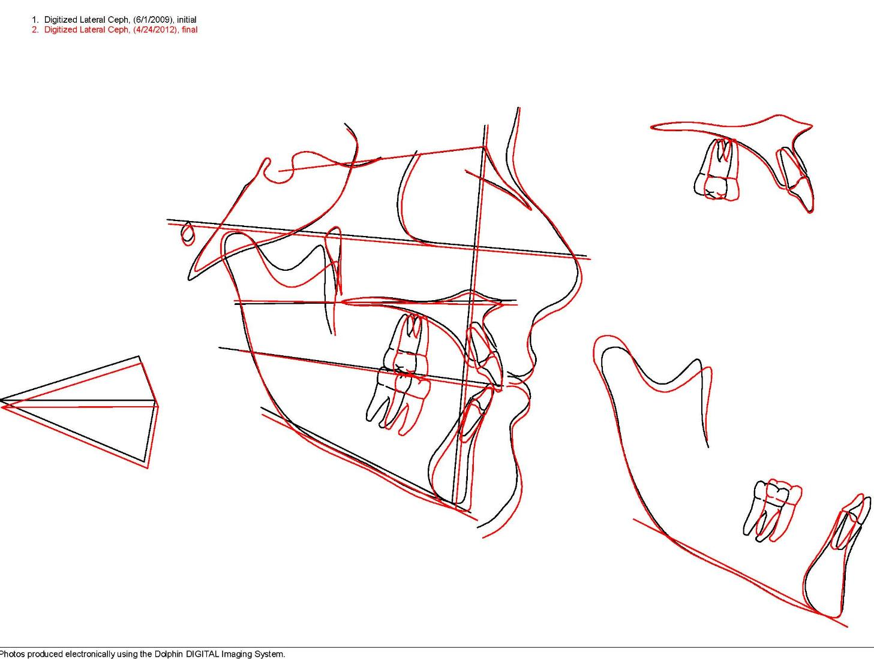
NAME Initial
Date Age
NAME Final
Date Age
Notes:
To change the picture, right click on the picture or photos and choose change picture. (You can choose change picture from the format picture menu as well) Select the file or picture that you want to replace the photos with from your computer. The “virtual labels” are moveable or not set so that you may move them as needed for your photos. Simply change the name, the date, and the age in the label. You can copy and paste this label into the other slides to save time or retype the information. If you copy and paste the label, you will need to copy and paste the “black dot” as well.

Slide 15
Progress Records
Follow instructions in the notes under the slides
Notes:
Under the progress records section, you would put your surgical records, your phase I records, and any other pertinent records that would help illustrate your patient’s treatment better for the group. There are two copies for your convenience. If you need more copies of each slide, then duplicate the slides by right clicking on the slides and choosing duplicate.

Slide 16
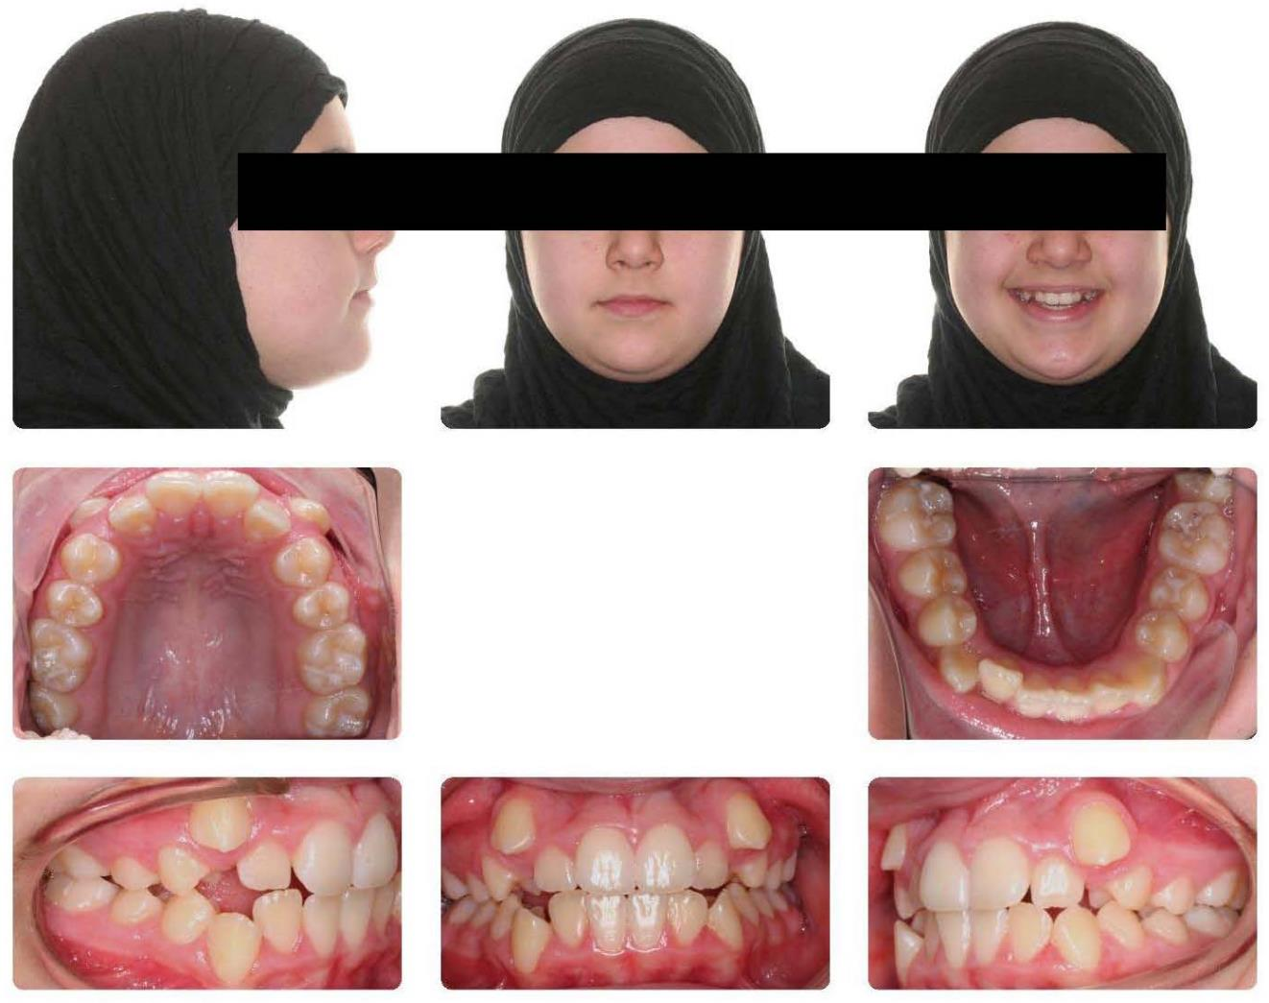
NAME Progress
Date Age

Slide 17
NAME Progress
Date Age

Slide 18
NAME Progress
Date Age

Slide 19
NAME Progress
Date Age

Slide 20
NAME Progress
Date Age

Slide 21
Name Progress
Date Age

Slide 22
NAME Progress
Date Age

Slide 23
NAME Progress
Date Age

Slide 24
NAME Initial
Date Age
NAME Progress
Date Age
Notes:
Please include superimpositions for the progress head films if they would be helpful to others.

Slide 25
Phase I Records
Follow instructions in the notes under the slides
Notes:
Use this section if you have phase I records. Phase I records would follow the same order as original records and be placed at the beginning of your notebooks so the treatment will flow in the natural sequence of events.

Slide 26
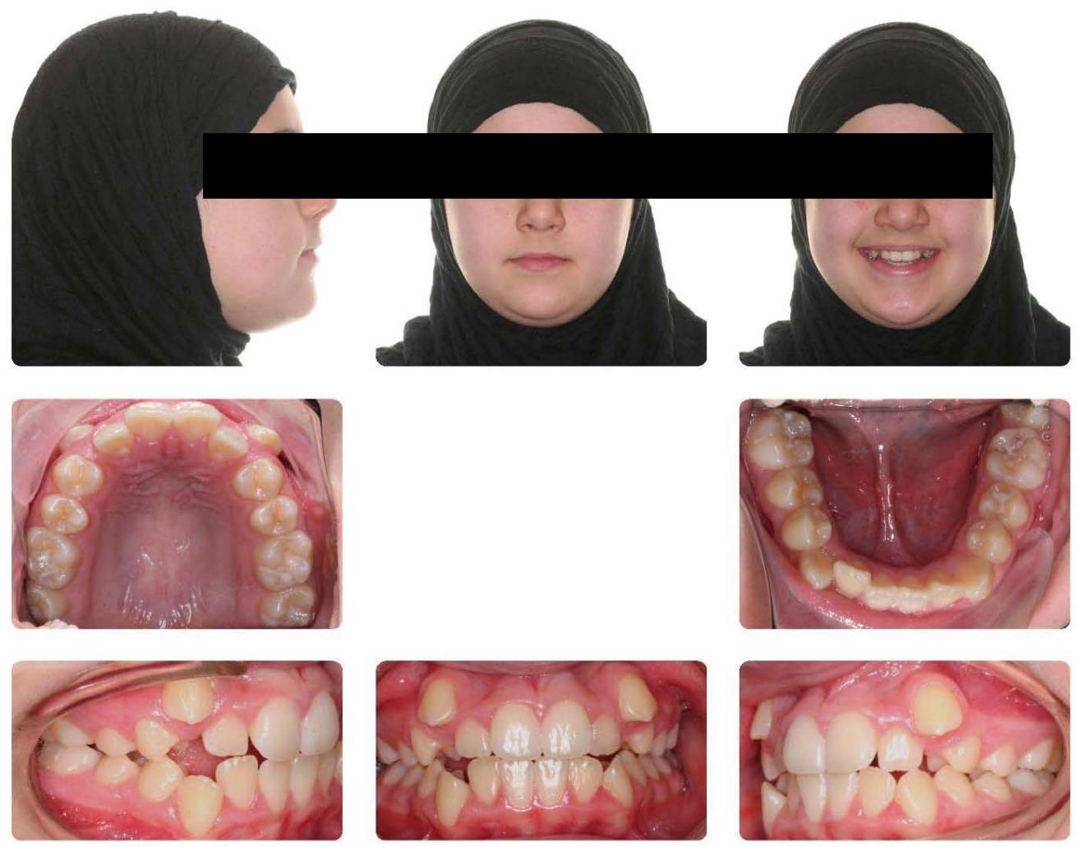
NAME Phase I Initial
Date Age
Notes:
Phase I records would follow the same order as original records and be placed at the beginning of your notebooks so the treatment will flow in the natural sequence of events.

Slide 27
NAME Phase I Initial
Date Age

Slide 28
NAME Phase I Initial
Date Age

Slide 29
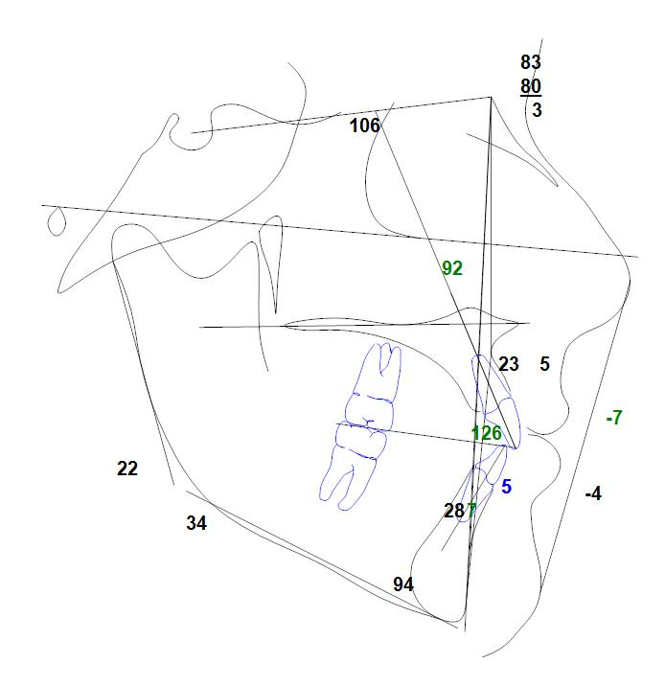
NAME Phase I Initial
Date Age

Slide 30

NAME Phase I Final
Date Age

Slide 31
NAME Phase I Final
Date Age

Slide 32
Name Phase I Final
Date Age

Slide 33
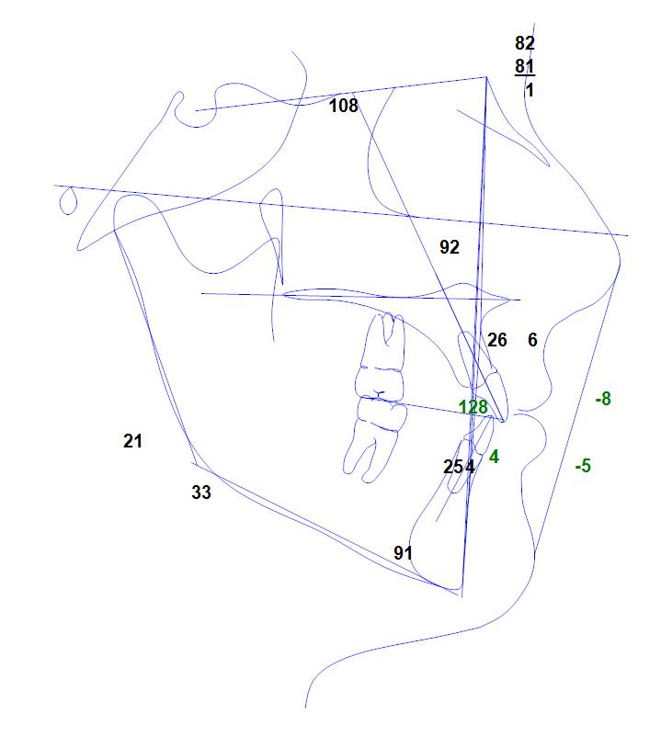
NAME Phase I Initial
Date Age

Slide 34
NAME Phase I Initial
Date Age
NAME Phase I Final
Date Age

Slide 35
NAME Phase I Initial
Date Age
NAME Phase I Final
Date Age
NAME Phase 2 Final
Date Age

Slide 36
Post-treatment
Follow instructions in the notes under the slides
Notes:
Use this section if you have post-treatment records available for review. Post-treatment records would be records of the patient out of retention at least 1-2 years from the removal of appliances.

Slide 37
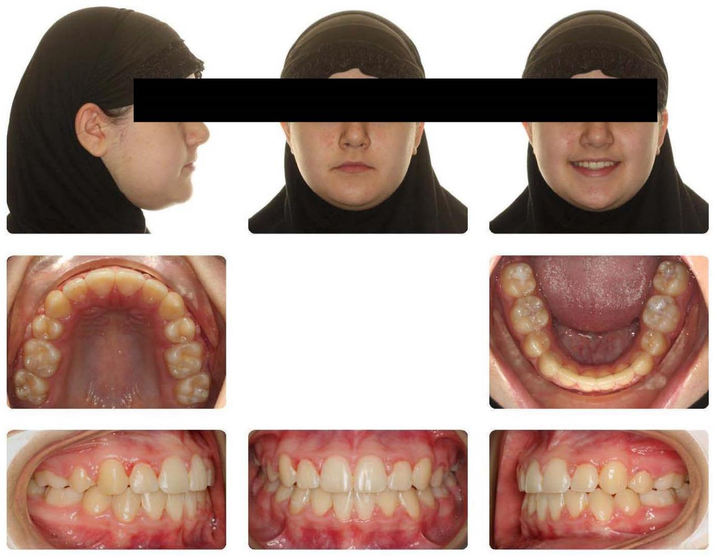
NAME Post-treatment
Date Age

Slide 38
NAME Final
Date Age

Slide 39
Name Post-treatment
Date Age

Slide 40
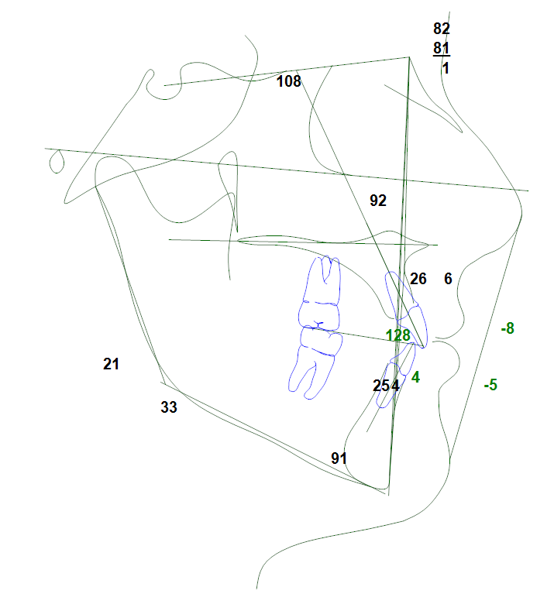
NAME Post-treatment
Date Age

Slide 41
NAME Initial
Date Age
NAME Post- Treatment
Date Age

Slide 42
NAME Final
Date Age
NAME Post- Treatment
Date Age

