Slide 1
Texas Orthodontic Study Club
GUIDELINES FOR TOSC CASE REPORTS

Slide 2
TOSC GUIDELINES FOR RECORDS
AND CASE WRITE-UPS
REQUIRED RECORDS: BEFORE TREATMENT AND AFTER TREATMENT
• Study models
• Periapical or panoramic radiographs
• Cephalometric radiographs
• Cephalometric tracings
• Facial photographs (frontal, profile, smiling)
• Intra-oral photographs (Five views: right, front, and left views of teeth in occlusion and the occlusal views of the upper and lower arches)

Slide 3
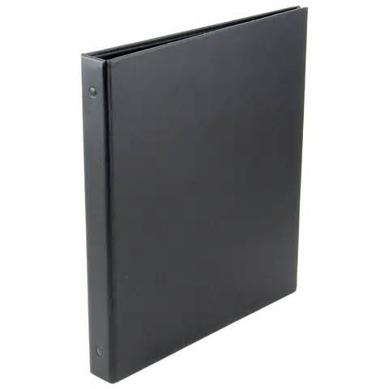
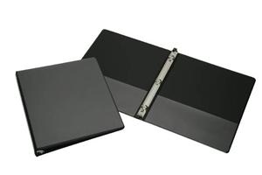
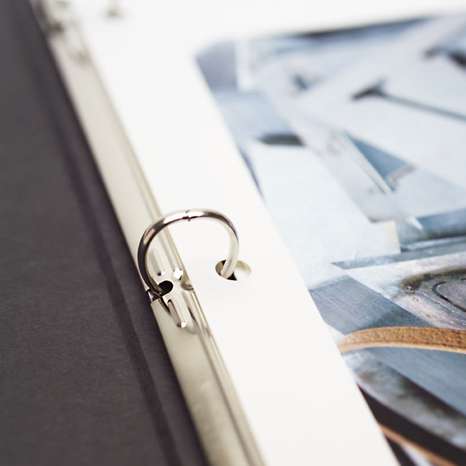
TOSC GUIDELINES FOR RECORDS
AND CASE WRITE-UPS
The following sections will detail the preparation of the case report notebook. Please follow the instructions exactly, as it is impossible to fairly assess case reports that differ in format, completeness, etc.
The notebook should be a 1/2” black binder with transparent acetate pages.
(Example: Office Depot Item # 1856098)

Slide 4
TOSC GUIDELINES CASE WRITE-UPS
(Use the TOSC notebook template for proper formatting of records)
Outside Front Cover- TOSC meeting cover page
Inside Front Cover- case information and brief treatment overview
Page 1-initial photos
Page 2-initial panorex
Page 3-initial cephalometric x-ray
Page 4-initial cephalometric tracing (black)
Page 5-final photos
Page 6-final panorex
Page 7-final cephalometric x-ray
Page 8-final cephalometric tracing (red)
Page 9-cephalometric superimpositions
Page 10 or more- supplementary information (Please include any progress photos, post-retention photos, or other pertinent information)

Slide 5
CEPHALOMETRIC TRACINGS
Tracings of the cephalometric xrays are required.
The original tracing is shown with black lines.
The progress tracing/tracings are optional and would include any cephalometric xrays between the original and final such as post- phase I or pre-phase II, etc. The progress tracing is in blue.
The final tracing is in red, and any post-treatment tracing are in green.
They must show the following lines: Sella-Nasion-SN Occlusal Plane-OP Mandibular Plane-MP or GoGn And the following angles: MPA-(SN-MP) SNA SNB.
Any additional measurements that you may use in your office related to diagnosis and treatment planning should be included.

Slide 6
COMPOSITE TRACINGS
Composite tracings are required.
Trace the before treatment head film in black near the upper limit of the page.
Superimpose this black tracing on the after treatment tracing, registering on Sella along SN. Trace the after treatment in red to show the overall growth and treatment changes.
Below this composite, superimpose the before and after treatment maxillae using the “overall” superimposition, tracing the before in black, and the after in red.
Just below the maxillary composite, superimpose the before and after mandibles, registering on the lower border and the lingual aspect of the symphysis. In determining the lower border, split the difference between right and left sides of the body and the ramus.
Please note that the dotted lines on the drawing included with these instructions represent the red “after” tracing. Both tracings should be in solid lines, one black and one red.
If a post-treatment tracing is used, it is to be traced in green in the same manner and superimposed with the original and final tracings on the same sheet of paper.

Slide 7
TOSC GUIDELINES FOR DIAGNOSTIC MODELS
Hand Held Models
Impressions should extend far enough to allow faithful reproduction of all soft tissue anatomy in the final models.
They should be trimmed to an overall height of 2 3/4” to 2 7/8”. The casts should be trimmed in centric occlusion. Documentation of significant differences between centric occlusion and centric relation should be provided (a bite registration is preferred).
Trimming or carving on the anatomical portion of the model should be limited to the removal of bubbles and the reduction of projections at the edges. Models smoothed or polished in such a manner that tooth and soft tissue detail is destroyed are NOT acceptable.
Original models are preferred to duplications and must conform to the display standards. If duplication is necessary, original anatomy should be carefully preserved.

Slide 8
Articulated Models
Models mounted in centric relation on an articulator may be used for case presentation. They should be poured in hard dental stone from good impressions and the mounting should be neat. The point of first contact should be marked with red articulating paper. A record of condylar displacement from CR to CO is desirable if the articulator has that capability.
Impressions should extend far enough to allow faithful reproduction of all soft tissue anatomy. The models should be mounted on the articulator in centric relation. Trimming or carving on the anatomical portion of the model should be limited to the removal of bubbles and the reduction of projections at the edges. The non-anatomic aspect of the mounted models should be smoothed and overall polishing achieved without loss of tooth and soft tissue detail. At least one articulator should be provided for each case presented.

Slide 9
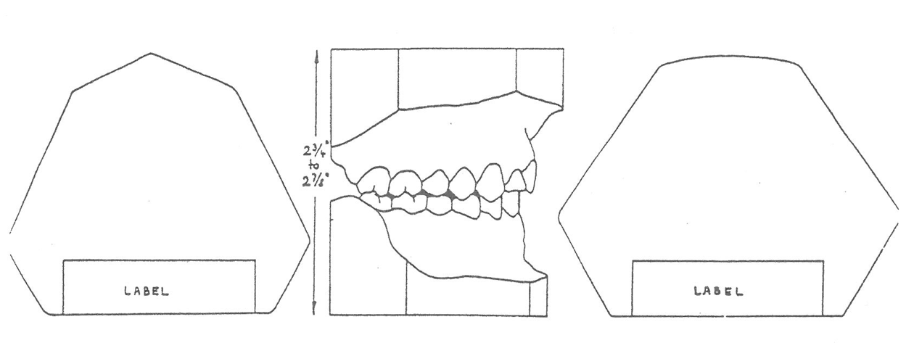
Labeling
Articulated models should be prepared as per hand held models, but affixed to the back of the model and centered in the dental cast area rather than the mounting base. The upper and lower casts should be labeled with white adhesive labels in the following format:
` Case No. Stage of Treatment
Name of Patient
Date Age
Stage of Treatment
Colored signal dots make model identification easier and should be used:
Beginning records-black
Finished records-red
Post-treatment records-green

Slide 10
TOSC GUIDELINES FOR PRESENTING DIGITAL MODELS
1. TOSC will follow the rules established by The American Board of Orthodontics in regards to the use of digital models.
2. It is recommended that laptop computers not be used to present digital models. The Texas Orthodontic Study Club will not accept responsibility for theft or damage to computer equipment.
3. A “Gallery View” printed image is required. The image should be printed using photo quality settings and photo quality glossy paper. The printed images should be displayed outside the notebook. Digital models are only allowed for INITIAL and INTERIM records. Plaster casts are required for
FINAL records.
4. The original image file must not be altered. The rules established by the ABO can be viewed at:
http://www.americanboardortho.com/professionals/clinicalexam/casereportpresentation/preparation/casts.aspx

